Slide 1

CORONA VIRUS ANALYSIS
SQL and Data Analysis Insights

Slide 2

Introduction
The Covid- 19 pandemic has had a significant impact on public health and has created an urgent need for data-driven insights to understand the spread of the virus. As a data analyst, I was tasked with analyzing a corona virus dataset to derive meaningful insights and present my findings.

Slide 3
Dataset Description
Overview of Dataset Columns:
Province: Geographic subdivision within a country/region.
Country: Geographic entity where data is recorded.
Latitude: North-south position on Earth's surface.
Longitude: East-west position on Earth's surface.
Date: Recorded date of CORONA VIRUS data.
Confirmed: Number of diagnosed CORONA VIRUS cases.
Deaths: Number of CORONA VIRUS related deaths.
Recovered: Number of recovered CORONA VIRUS cases.

Slide 4
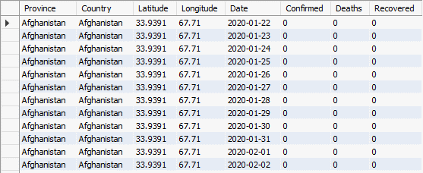

Slide 5
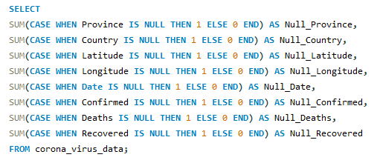
Dataset Cleaning
Process: Explain the process of checking for NULL values.

Slide 6
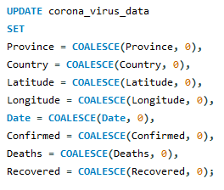
Data Imputing
Imputing NULL values to zeros

Slide 7


Dataset Overview
Total Rows: Display the total number of rows.
SQL Code Snippet

Slide 8
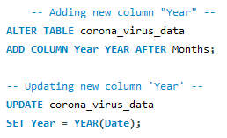
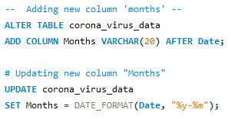
Dataset Overview
Added two new columns Months and Year.
SQL Code Snippet

Slide 9
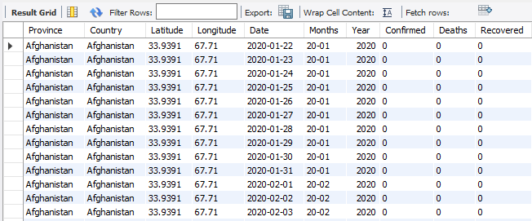
Dataset Overview

Slide 10


Date Range Analysis
Range: Show the start and end dates of the data.
SQL Code Snippet

Slide 11


Monthly Analysis
Months Count: Show the number of months present.
SQL Code Snippet

Slide 12
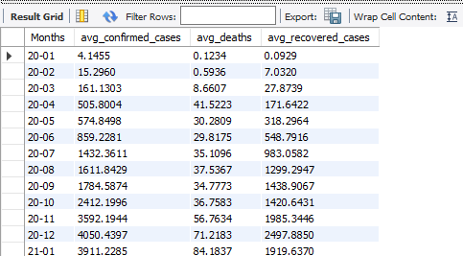
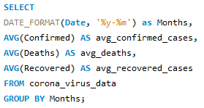
Monthly Averages
Metrics: Display monthly average of confirmed, deaths, and recovered cases.
SQL Code Snippet

Slide 13
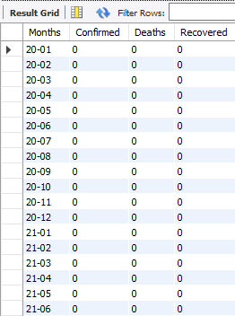
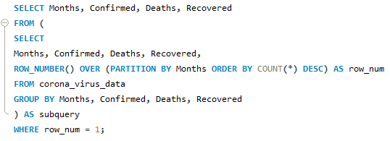
Most Frequent Values
Values: Show the most frequent values for confirmed, deaths, and recovered cases each month.
SQL Code Snippet

Slide 14
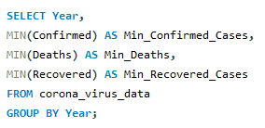
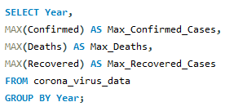


Annual Min/Max Values
Metrics: Display minimum and maximum values per year.
SQL Code Snippet

Slide 15
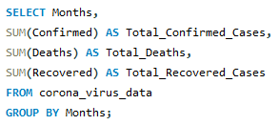
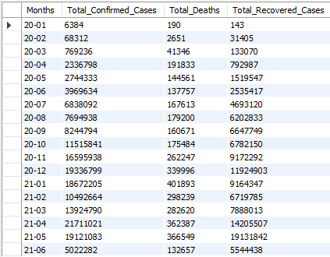
Total Cases Per Month
Metrics: Show the total number of confirmed, deaths, and recovered cases each month.
SQL Code Snippet

Slide 16
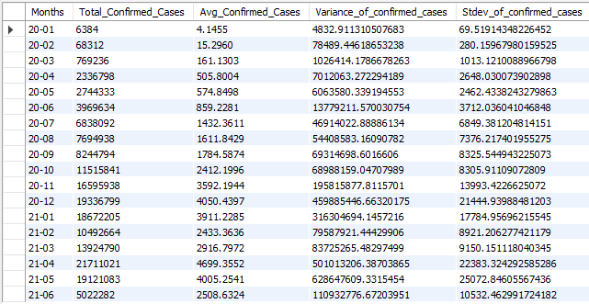
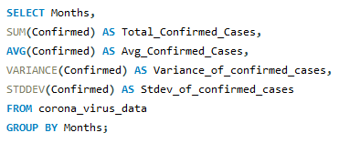
Spread Analysis (Confirmed Cases)
Metrics: Statistical analysis by Month
SQL Code Snippet

Slide 17
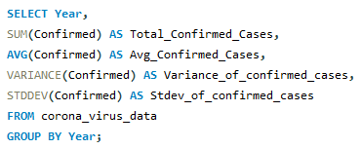
Spread Analysis (Confirmed Cases)
Statistical analysis by Year
SQL Code Snippet

Slide 18
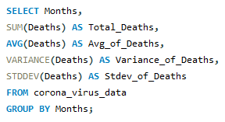
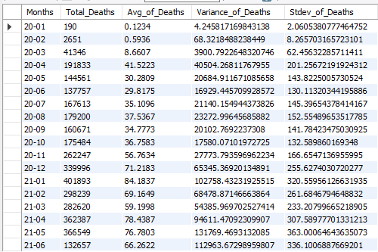
Spread Analysis (Death Cases)
SQL Code Snippet

Slide 19
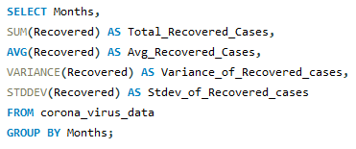
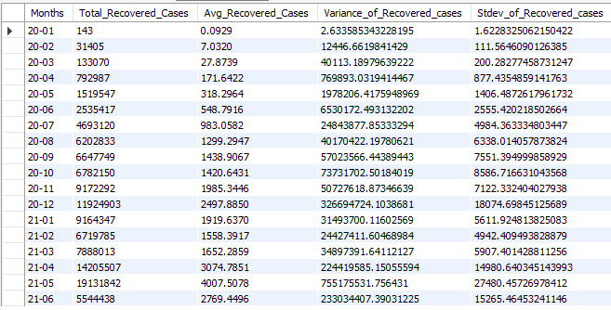
Spread Analysis (Recovered Cases)
SQL Code Snippet

Slide 20
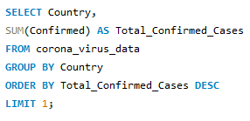

Country Analysis
Highest number of confirmed cases
SQL Code Snippet

Slide 21
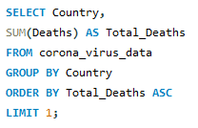

Lowest Death Cases Country
Country with the lowest number of death cases.
SQL Code Snippet

Slide 22
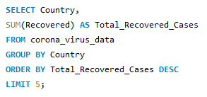
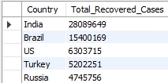
Top Recovered Countries
Top 5: Countries with the highest recovered cases.
SQL Code Snippet

Slide 23
Conclusion
Data Cleaning and Preparation:
NULL values are updated to zeros.
Analysis covered data from January 2020 to June 2021 (18 months).
Monthly Trends:
Significant peaks in confirmed cases during March and November 2020.
Statistical Analysis:
Total confirmed cases: 16,90,65,144
Average monthly confirmed cases: 93,92,508
Total Death Cases : 36,47,894
Total Recovered Cases: 11,30,89,548

Slide 24
Conclusion
Geographical Insights:
Highest confirmed cases: US
Lowest death cases: Dominica
Top recovery rates: 1. India
2. Brazil
3. US
4. Turkey
5. Russia

Slide 25
Thank You . . .

